Slide 1
Accelerating the Flow of Value with SAFe®
Dean Leffingwell
Creator of SAFe and Chief Methodologist
Notes:
While leading the development of SAFe during the last few years // I’ve come to reflect more and more on the inherent nature of agility itself.
While it might appear to be as, if-you-will, “settled law” at this point // the fact is that agility does not seem to be a natural state in the enterprise.

Slide 2
Agile is such a critical, desirable, elusive, and yet intangible state.
Perhaps it’s more productive to focus on delivering a continuous flow of value than debate the question of whether “I, and my team, are Agile or not?”
Notes:
While we generally make great forward strides and we can revel in that // and the results it enables //
I’ve also witnessed
// new teams struggling to achieve the basic Agile practices
// good teams occasionally regressing
// leaders struggling with the abstract concepts and the changes it requires
// and even individual practitioners who are not so comfortable with what we assumed was a natural inclination to act and be more Agile.
I admit that this last one came as a bit of surprise, at least to me.
Let’s face it // Agile is hard // and twenty plus years in // the journey is far from complete.
I came to an interesting personal conclusion. //
Focusing on delivering a continuous flow of value may be more fruitful than focusing on the question of whether “I, and my team, are Agile or not?”
The former appears to be measurable and outcomes based // the latter seemingly leads to endless philosophical debates about what is or isn’t Agile // and whether it should or shouldn’t be a goal unto itself.
So perhaps we should focus on flow for a bit and see where that takes us.

Slide 3
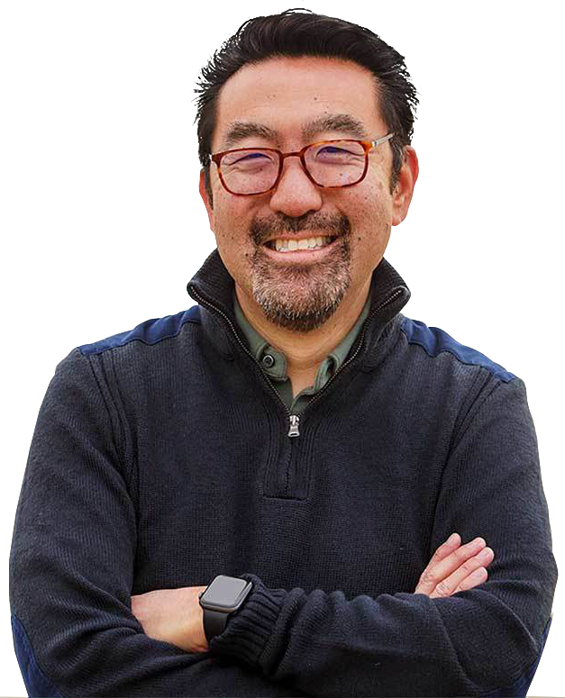
“To enable fast and predictable lead times in any value stream, there is usually a relentless focus on creating a smooth and even flow of work.”
—Gene Kim et al., The DevOps Handbook
- 3 -
© Scaled Agile, Inc.
- 3 -
Notes:
While Flow is a relatively newer thought in tech // it isnt alarmingly new. Lean manufacturing and lean development have always had a strong emphasis on flow.
And as Gene Kim notes // “To enable fast and predictable lead times in any value stream, there is usually a relentless focus on creating a smooth and even flow of work.”
// The fact is that any modern and effective continuous delivery pipeline is there for that reason // to facilitate a fast flow of value from ideation to delivery.
Indeed that’s the point.

Slide 4
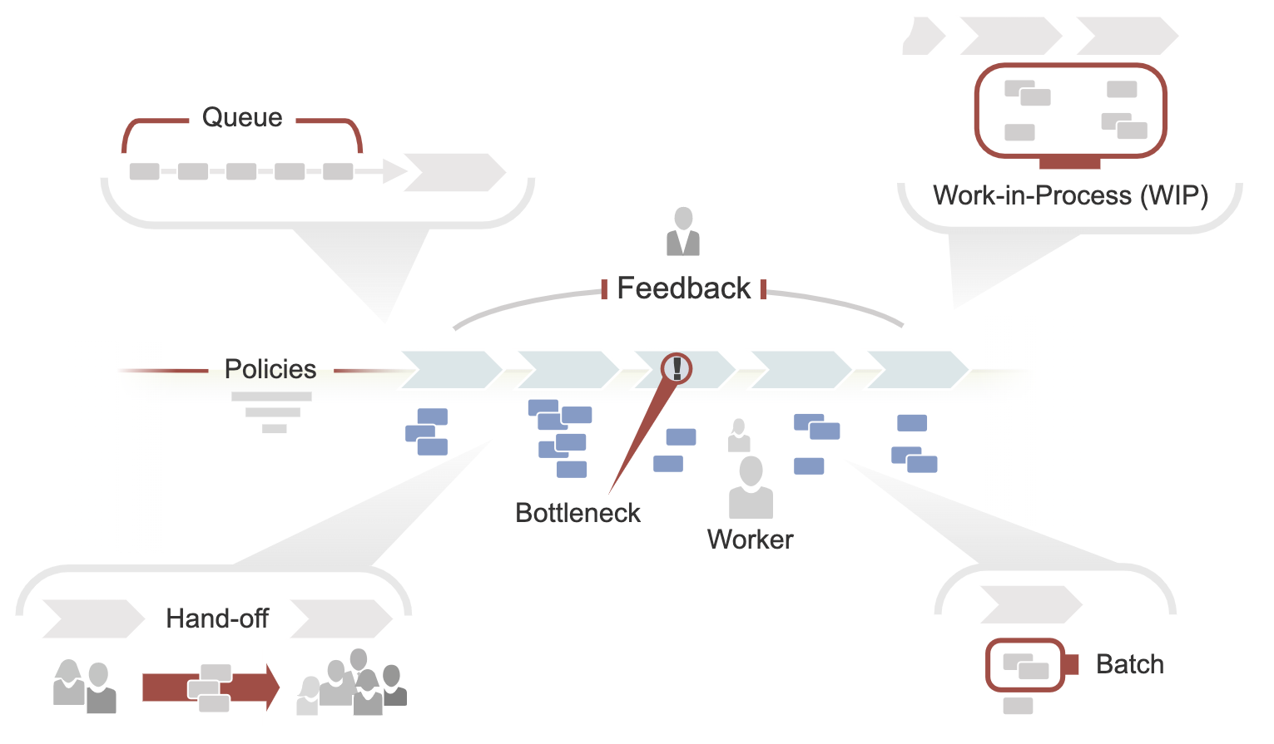
Eight properties of a flow-based system
1
6
Work-in-Process (WIP)
Bottleneck
Hand-off
Feedback
Batch
Queue
Worker
Policies
4
8
3
5
2
7
- 4 -
© Scaled Agile, Inc.
Notes:
But when we ‘double click’ on flow, it becomes necessary to understand what a system of flow actually is within in our software and solution development content. It required some deeper thinking and some more basic research. //
So we did that work over the course of a year or so // talking to experts like Mik Kerstin // going back to Reintersens work on product development flow // indeed all the way back to Godratt and others
We’ve now come to understand that there are eight essential properties to every flow system //. They are pictured here.
They are:
Work in process. There is always some work in process. if there werent, there would be no flow
Batch size. All the work can’t be done at once. Therefore, work through the system occurs in batches.
Queue. It all starts with a set of work items to be done. If there is no queue // there is no work.
Worker. People do the critical work of moving work items from one state to another.
Policies. Policies are integral to flow. They may be local policies — like team-based policies that determine how a work item moves from step to step — or global policies like those that govern how work is performed
Bottlenecks. In every flow system, one or more bottlenecks effectively limit the flow through the system.
Handoffs. Handoffs wouldn’t be necessary if one person could do all the work. But many individuals and teams are needed to produce value.
Feedback. Customer and stakeholder feedback is integral to efficient and effective flow.
And if you know the eight properties // you‘ll be motivated to think about what you might do to mitigate any impediments that restrict the flow through the system.
In other words // we need an accelerator to understand and improve flow for each of the properties
So, let’s dive in to the eight accelerators of a flow based system

Slide 5
#1
Visualize and Limit WIP
Notes:
#1 Visualize and limit WIP

Slide 6
#1 Visualize and Limit WIP
This is not a new principle, and yet…
Think about:
Portfolio Backlog
Funnel
Review
Analyzing
Implementing
Done
Are you visualizing the WIP you need to visualize?
How do you react to it?
How is this different at different levels?
Where is it most critical?
Portfolio Kanban
Notes:
Overloading a system with more work than can be reasonably accomplished confuses priorities // causes frequent context switching // and increases overhead. It overloads people and their brains // scatters focus // reduces productivity and throughput // and increases wait times for new functionality. // And its frustrating.
The first step is to make the current WIP visible to all stakeholders. A Kanban board is a simple way of doing that.
Often // simply visualizing the current volume of work is the wake-up call that causes practitioners to start addressing the systemic problems of too much work and too little flow.
The next step is to start balancing the amount of WIP against the available capacity. This is done by establishing—and continually adjusting—WIP limits for the relevant states.
Limiting WIP, however, requires knowledge // discipline // and commitment. It may even seem counterintuitive at first
Here’s some things to think about:
→Are you visualizing the WIP you need to visualize?
→How do you react to it?
→How is this different at different levels?
→Where is it most critical?

Slide 7
#2
Address Bottlenecks
Notes:
#2 Address bottlenecks

Slide 8
#2 Address Bottlenecks
Bottlenecks occur wherever demand is greater than capacity. Bottlenecks cause the system to operate below its potential capacity.
Think about:
Do you know where the bottlenecks are?
Do you know how to find them?
Do you know what to do about them when you do?
Notes:
Bottlenecks occur wherever people or resources // systems, materials, and so on // in the flow of value experience demand greater than the available capacity. // Examples include a shortage of a specialized skills // insufficient build servers in the CI/CD pipeline // or a silicon supply shortage for building a cyber-physical system. // Work piles up at a bottleneck and limits the effective throughput of value // as the figure illustrates.
Bottlenecks cause the value stream to operate slowly and uneconomically // far below its potential capacity. // By the theory of constraints // investment in optimizing the system at any other point than the dominant bottleneck is waste // as it will not improve the throughput of the system.
Bottlenecks must be found and addressed by adding additional skills // people // or other resources at the bottleneck step. // While that is not always easy to do // there are reasons why the bottleneck is a bottleneck // eliminating bottlenecks must be a primary focus as throughput will not increase until the bottleneck is addressed.

Slide 9
#3
Minimize Handoffs and Dependencies
Notes:
3. Minimize handoffs and dependencies.

Slide 10
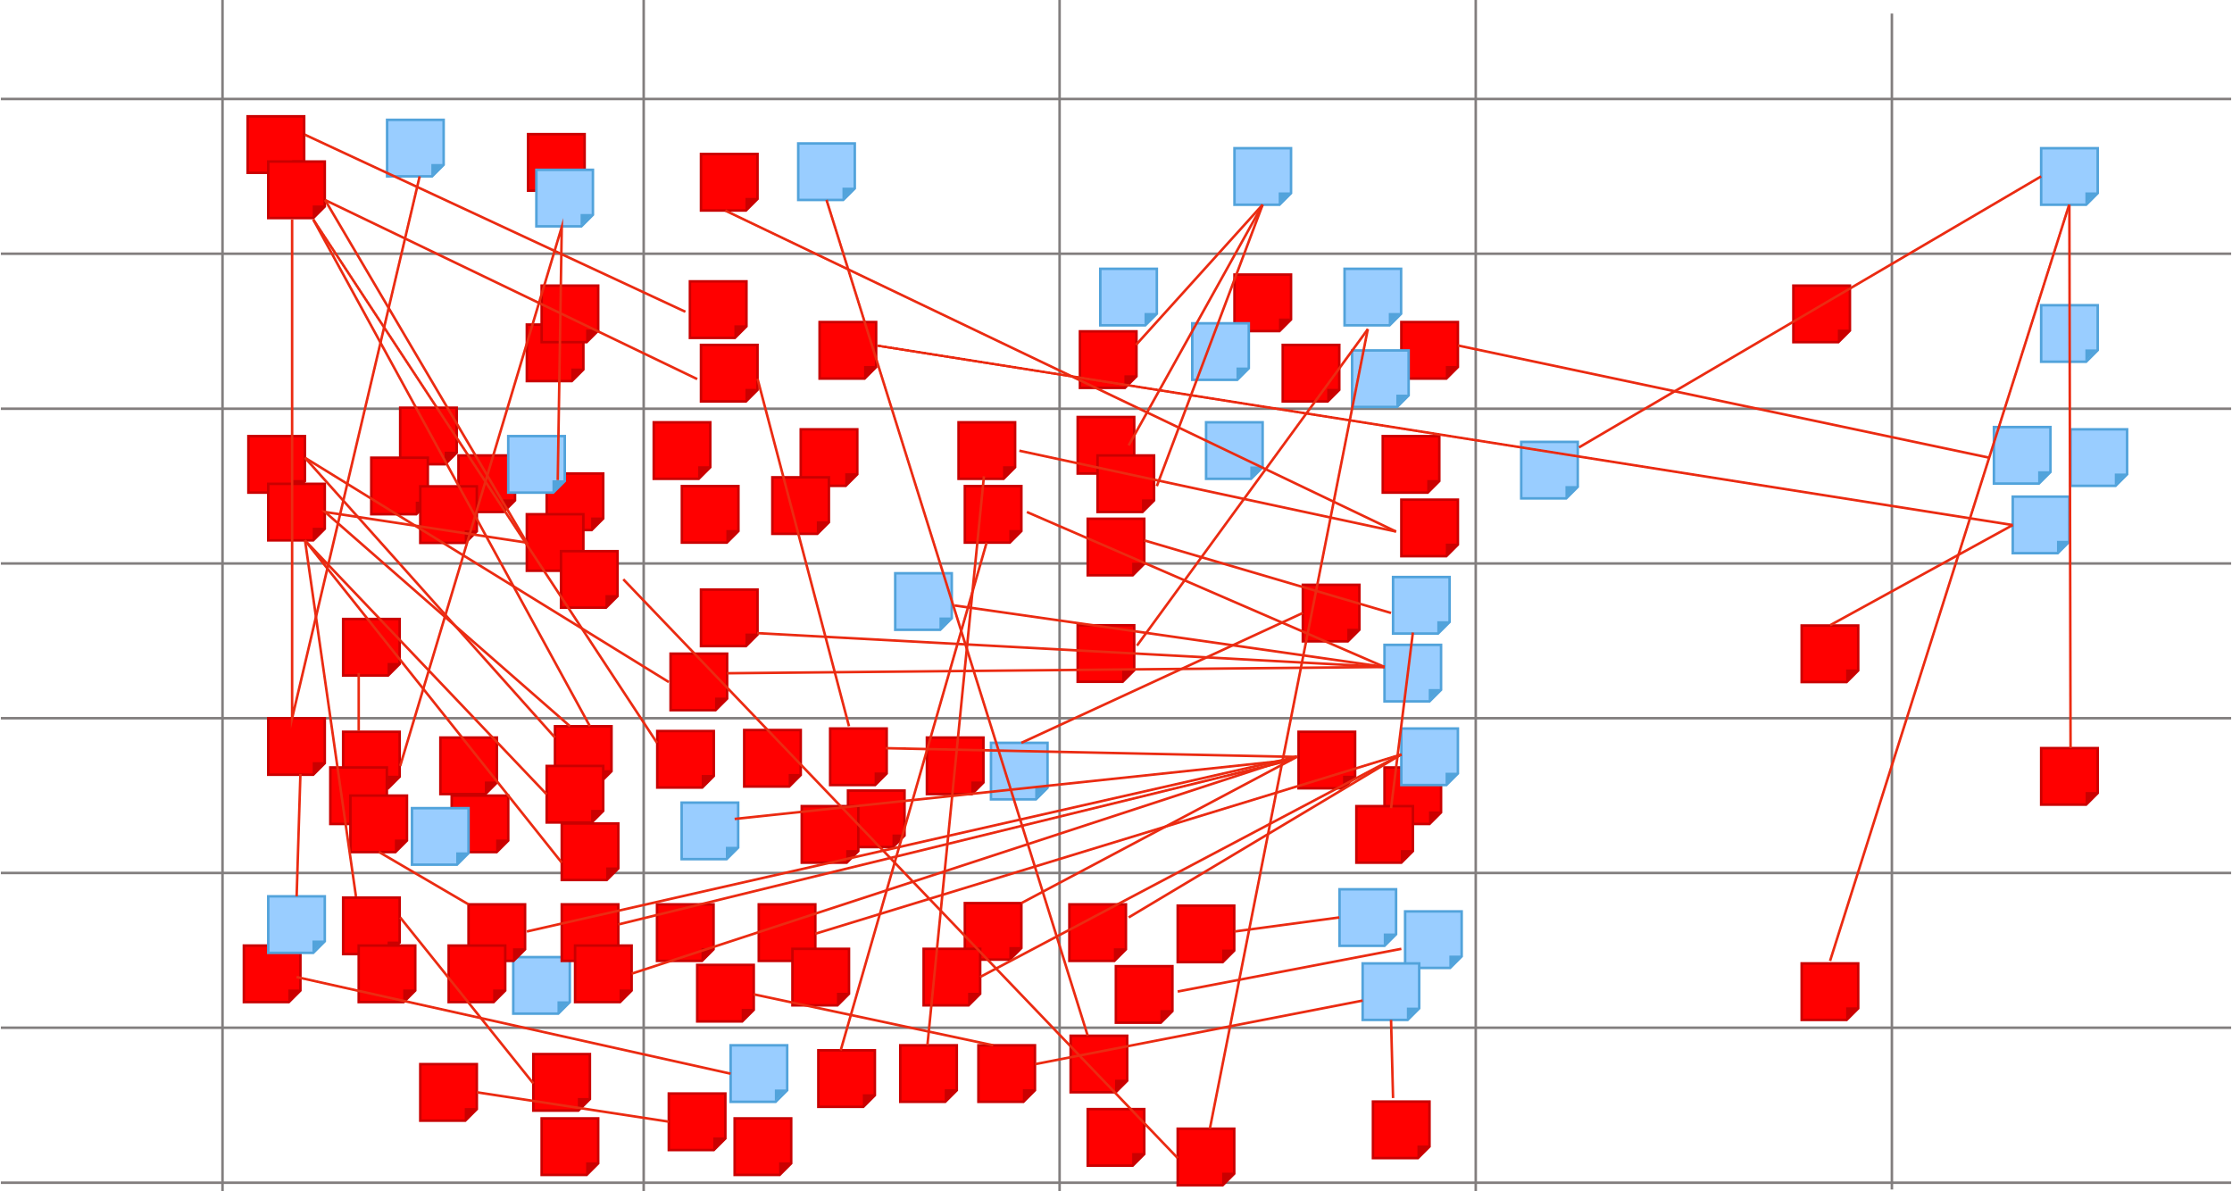
#3 Minimize Handoffs and Dependencies
We all know excessive handoffs cause waste, delays, and rework, slooowww value delivery, and lost opportunities.
Think about:
Have you applied team topologies yet?
Do you think “T Skills” every time you see this?
Is it time to restructure your Teams, ARTs, or Value Streams?
Notes:
Handoffs occur whenever there is a separation between knowledge // responsibility // action // and feedback. // For example // dependencies happen between teams when the work of one team cannot continue until related work by another team is completed. // This results in development waste in the form of wait states in the flow of value and also to lead to rework as the knowledge transfer is imperfect // causing further delays.
The solution is to create teams and ARTs with all the knowledge // resources // skills // and decision-making authority needed to create an end-to-end flow of value. // Activities like value stream mapping // forming stream-aligned teams // retros // and the I&A problem-solving workshop // can help identify the root causes and potential solutions to ‘too many handoffs’.
Here’s some things to think about:
Have you applied team topologies yet?
Do you think “T Skills” every time you see this board?
Maybe it’s time to restructure your teams // your ARTs // or your value streams. // Because value moves and your organization has to evolve.

Slide 11
#4
Get Faster Feedback
Notes:
Get faster feedback.

Slide 12
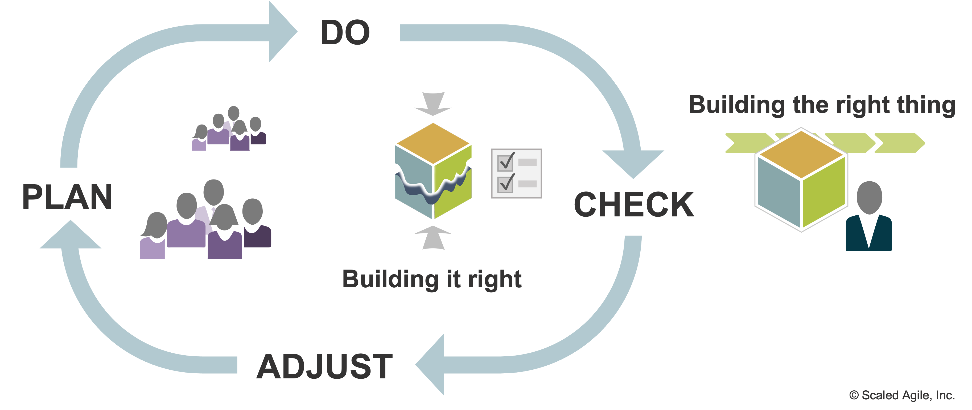
#4 Get Faster Feedback
We need both technical and customer feedback and we need it earlier, and more often than we think.
Think about:
How do you get this feedback now?
Is it early enough?
Faster feedback may well ‘save the day’ on your initiative
Notes:
Learning is the engine that powers product development. // We must get positive and negative feedback into the development process as early and continuously as possible.
But that can be difficult for a variety of reasons // for example:
Lack of direct access to customers
Delays in the development value stream
Late or infrequent integration
As the figure illustrates // we need two types of feedback from each PDCA cycle
Feedback about building the right thing. This feedback can only come from those users // customers // and economic stakeholders who can measure a solution’s actual value.
Feedback about building it right. Each PDCA cycle also evaluates if the right technology is applied to optimally solve the customer’s problem and meet the critical nonfunctional requirements (system ‘ilities”).

Slide 13
#5
Work in Smaller Batches
Notes:
# 5 Work in smaller batches.

Slide 14
#5 Work in Smaller Batches
If you want to:
Get faster feedback
Reduce the load on bottlenecks
Reduce variability
Reduce overhead
Increase efficiency
Increase motivation and urgency
Reduce schedule cost and growth
Then work in smaller batches!
“Batch size reduction saves much more than you think.”
—Don Reinertsen
The Principles of Product Development Flow
Notes:
Faster feedback is one of the primary reasons for working in smaller batches. // The smaller the batch size // the faster teams can collect and evaluate the feedback to adjust. // Moreover // since each item in the batch has some variability // larger batches accumulate more variability.
The economically optimal batch size depends on the holding cost // (the cost for delayed feedback // inventory decay // delayed value delivery // and so on) // and the transaction cost (the cost of preparing and implementing the batch). //
Reducing batch size typically involves investment in automating the Continuous Delivery Pipeline // including infrastructure and automation // continuous integration // builds // regression testing // and more. // Shorter increments also help to reduce batch size. So, if you want to:
Get faster feedback
Reduce the load on bottlenecks
Reduce variability
Reduce overhead
Increase efficiency
Increase motivation and urgency
Reduce schedule cost and growth
Then work in smaller batches!

Slide 15
#6
Reduce Queue Length
Notes:
#6 Reduce queue length.

Slide 16
#6 Reduce Queue Length
The longer the queue, the longer the wait for cool new stuff, regardless of the team’s size or efficiency.
Think about:
Can you see the queues?
How do you control queue length?
Notes:
Reducing the length of the queue that is feeding the system is another critical way to accelerate flow. // As we have all experienced // long queues are fundamentally bad. // They introduce waste // delays // and information decay. // In addition // Little’s Law says that the average wait time for a new time equals the average queue length divided by the average processing rate.
For solution development // the longer the queue of committed work awaiting implementation // the longer the wait time for new features // regardless of the team’s efficiency.
Reducing queue length decreases delays // reduces waste // increases flow // and improves predictability.
Here’s some things to think about:
Can you see the queues?
How do you control queue length?
Here’s an idea. // The next time you visit your favorite coffee shop // observe the queues and track the average queue length // process time// and total wait time. // When I actually did that // I started to finally understand queuing theory.

Slide 17
#7
Optimize Time ‘In the Zone’
Notes:
# 7 - Optimize time in the zone

Slide 18
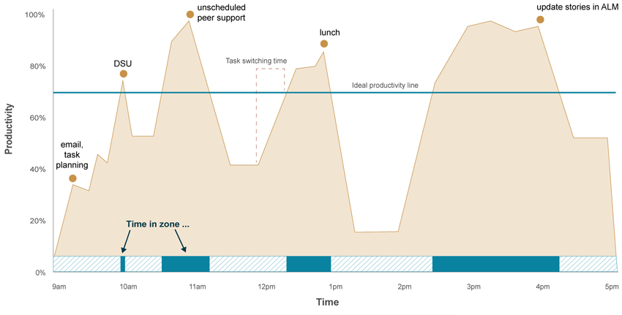
Do your people work like this?
Time ‘in the zone’ is often a fraction of the total workday
30%
of work day spent in zone
2.4 hrs (time in zone)
8 hrs (full day)
Notes:
Do your people work like this, where interruptions and multitasking rule the day // and their time in the productive zone is a small subset of the day?
Do you sometimes feel the same frustration?

Slide 19
#7 Optimize Time ‘In the Zone’
People in the zone demonstrate higher creativity, productivity, happiness, and fulfillment.
“Being ‘in the zone’ is an engaged mental state of extreme focus. The work feels effortless and time passes quickly.”
Think about:
What can you do to better optimize time in the zone for knowledge workers?
—Mihaly Csikszentmihalyi
Flow, The Psychology of Optimal Experience
Notes:
Being ‘in the zone’ is an engaged mental state of extreme focus where the work feels effortless // and time passes quickly. // People and teams in the zone demonstrate higher creativity // productivity // happiness // and fulfillment.
Getting into this mental state requires uninterrupted focus time // autonomy // competence // and connectedness.
Contrast this to the conditions in a work environment where work occurs in functional siloes in a batch-queue-handoff system. // There is an essential connection between creating a continuous flow of value and creating a working environment where individuals and teams can maximize their time in the zone.
But being in the zone is not just “headphones” on. // Effective team meetings // mob programming // pairing and peer review are just some examples of productive team “zones.”
Ask yourself // What can you do to better optimize time in the zone for knowledge workers?

Slide 20
#8
Remediate Legacy Policies and Practices
Notes:
# 8 Remediate legacy policies and Procedures

Slide 21
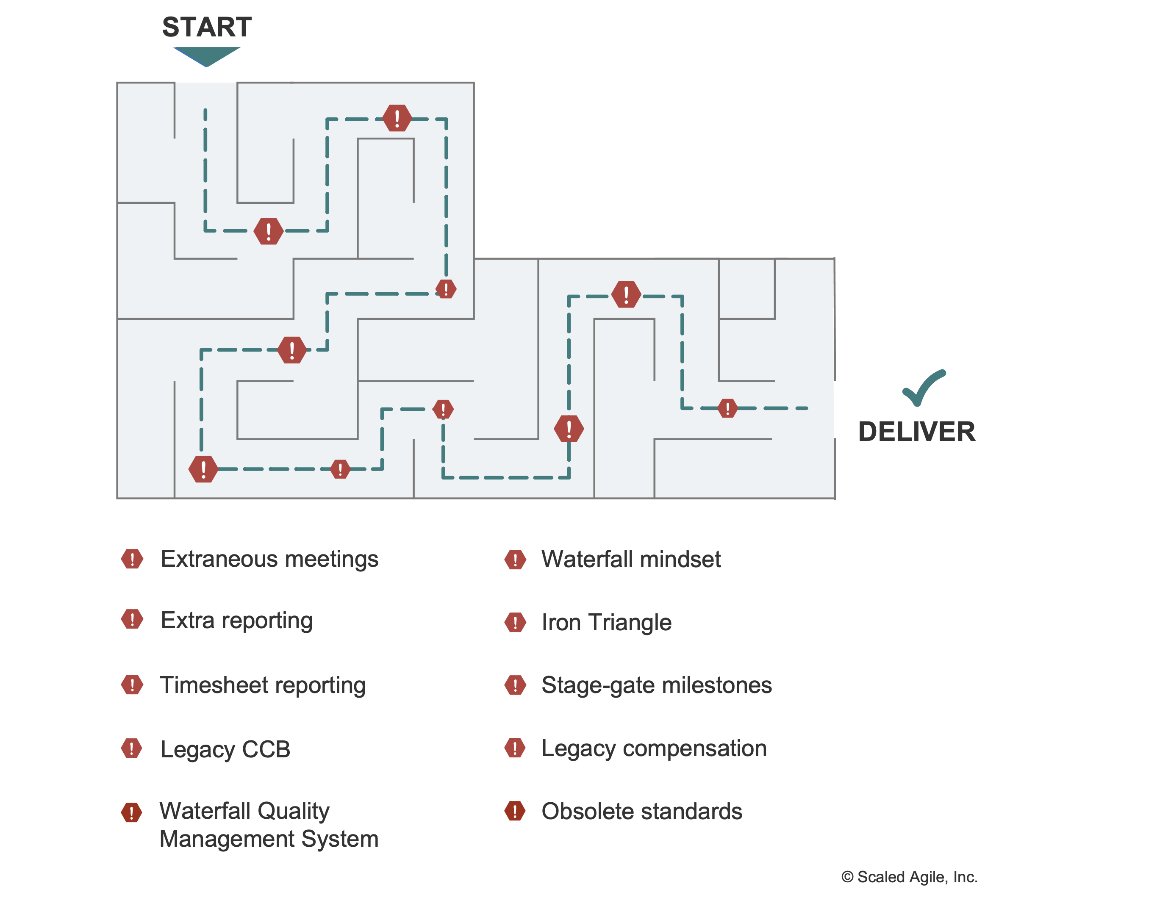
#8 Remediate Legacy Policies and Practices
Enterprises are often replete with legacy policies and practices that inhibit flow.
Look at the maze on the right.
Do you recognize any?
Do you have others?
What can you do to remediate?
The maze of legacy policies and practices
Notes:
Enterprises must constantly look out for legacy policies and practices that inhibit flow. // Many of these practices are ingrained in the culture // and are described as “we’ve always done it this way.”
Examples are many // some legendary:
Continued reliance on phase-gate milestones and the iron triangle of fixed scope // resources // and time.
Obsolete or unnecessary change control boards // extraneous oversight and reporting
Waterfall-based quality management systems for regulations and compliance
Obsolete tech standards // design specifications // audit practices // and the like // in environments where they are not mandated or required for quality
Timesheet reporting in addition to Agile Lifecycle Management (ALM) tooling // requiring double recording of time
Performance reviews and compensation policies that cause unhealthy competition
And that’s not an exhaustive list. // While many of these patterns may well have solved problems in the past // they now create new problems that become ongoing impediments to flow.
They must be proactively or reactively discovered // eliminated // modified // or mitigated.

Slide 22
Next steps
Read the new Flow article series at scaledagileframework.com
Tune your team for flow
Apply the accelerators
Deliver value continuously
Have fun!
© Scaled Agile, Inc.
- 22 -
Notes:
That summarizes the eight flow accelerators. So // what do we do with all this new information about moving to flow?
Here are my suggestions:
Read the new flow article series. You can start with the QR code here that takes you directly to the overview article.
Tune your team method to // and instrument for //flow. // The former might be a pretty big change depending on your team circumstances // and I don’t want to under-emphasize the effort there. // But the latter shouldn’t be too hard because the competent ALM tools generally provide excellent facilities for doing that // without burdening the team with unnecessary overhead.
Assess what you’ve got and how you are doing. // Keep in mind that “The facts are friendly” // an early mentor taught me that // and they are your facts // after all. // I promise you’ll see some things you can’t ‘unsee’.
Apply the eight flow accelerators to continuously reduce the impediments to flow. // There is work involved // but that’s the important work of getting stuff through your system faster.
Then // you’ll be able to deliver value ever-more continuously.
And lest we forget // building the world’s most important systems is both hard and rewarding work // so let’s have more fun while we do it!

